Slide 1
Setting up an RStudio server on an AWS instance
Barney Williamson, Jamie Fraser
13 April 2022

Slide 2
Contents
Configure and launch AWS instance
Connect to AWS instance
Install Git, clone repo and install RStudio server
Log in to RStudio server

Slide 3
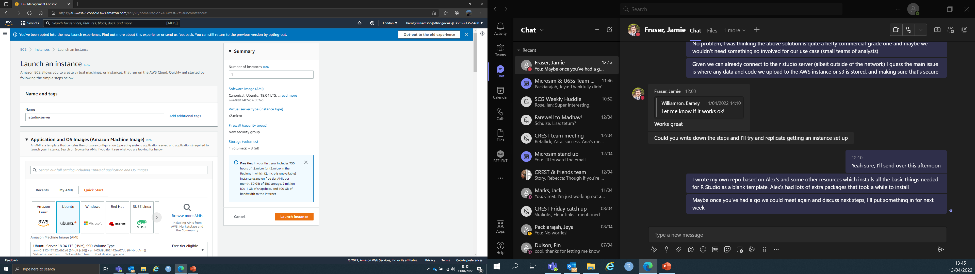
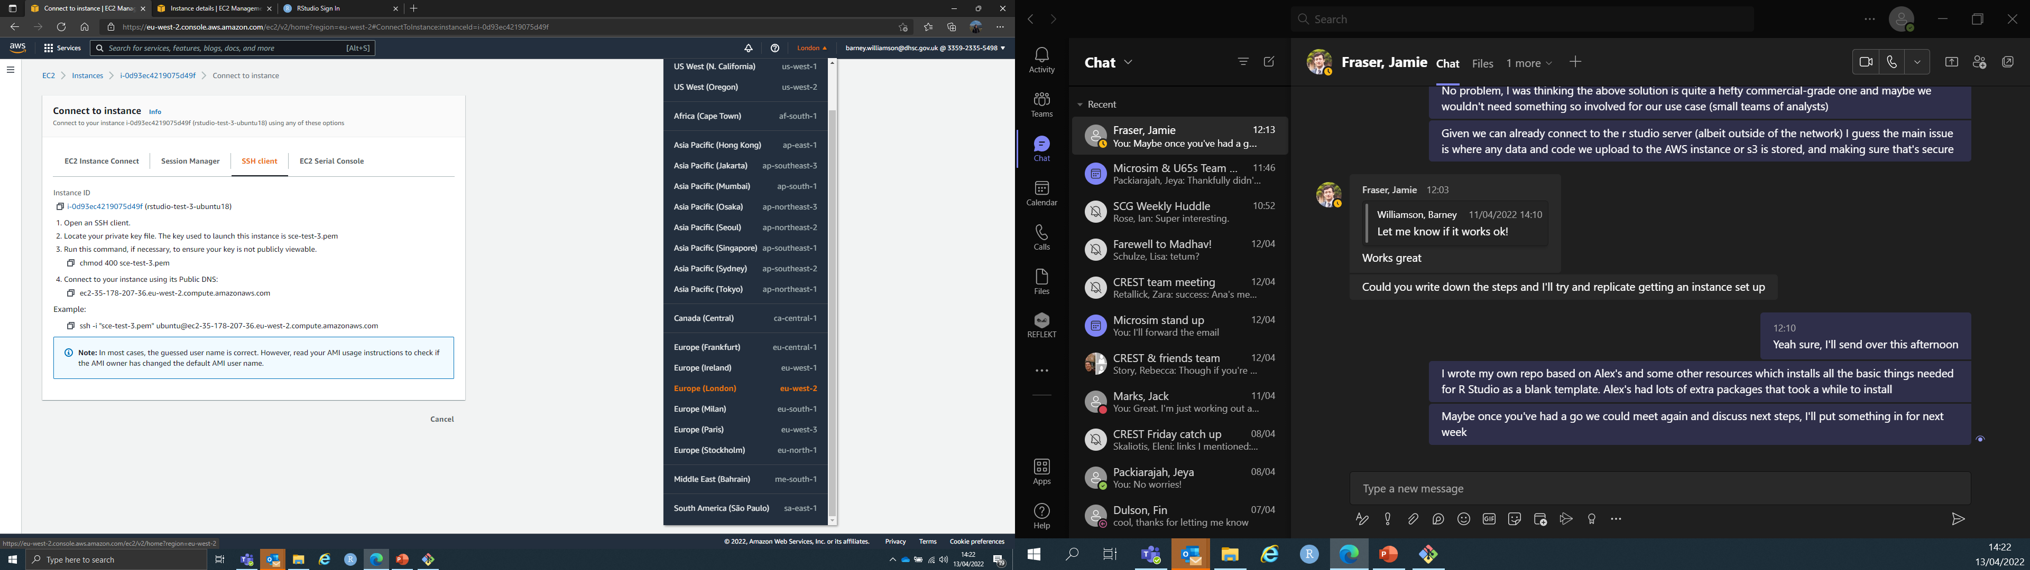
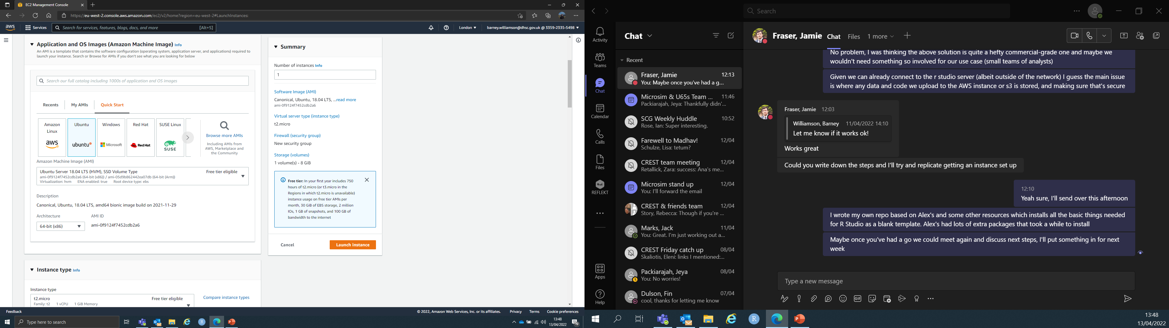
1. Configure and launch AWS instance
In the AWS toolbar select ‘Europe (London) eu-west-2’ from the region dropdown
Go to EC2 launch and name your instance
Under the Amazon Machine Image options go to Quick Start > select Ubuntu > use the drop down to select Ubuntu server 18.04
You need to use Ubuntu 18.04 for default RStudio Server to work

Slide 4
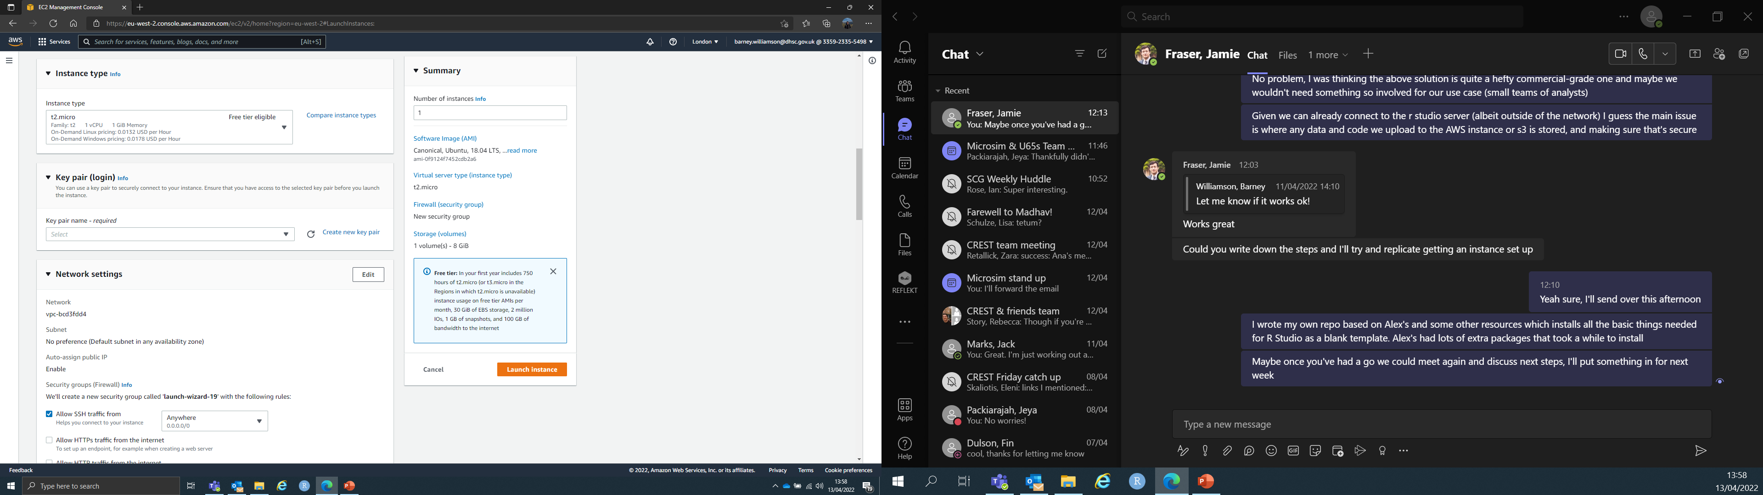
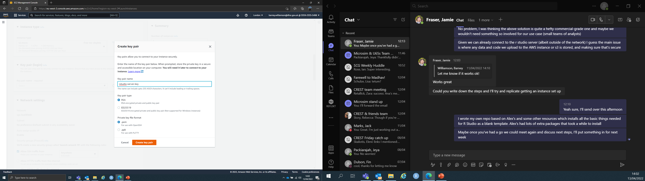
1. Configure and launch AWS instance
Choose instance type (which includes hardware options)
Above free tier are options to add more CPUs and memory
Create a new key pair and download it
Keep this key pair safe, you will need it to SSH to your instance

Slide 5
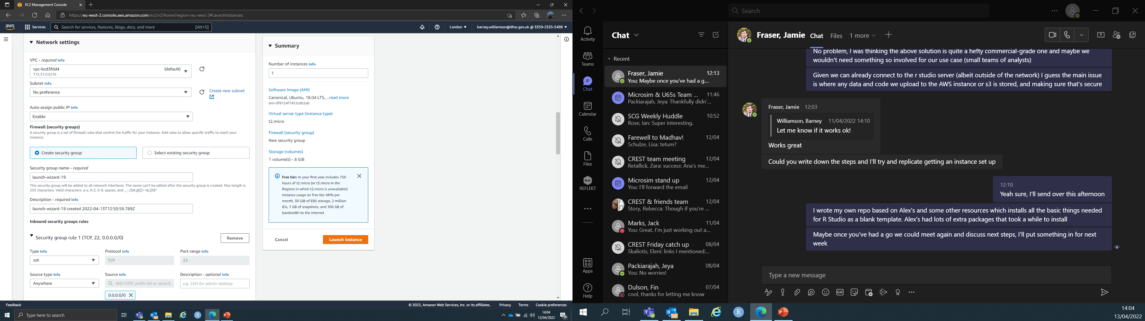
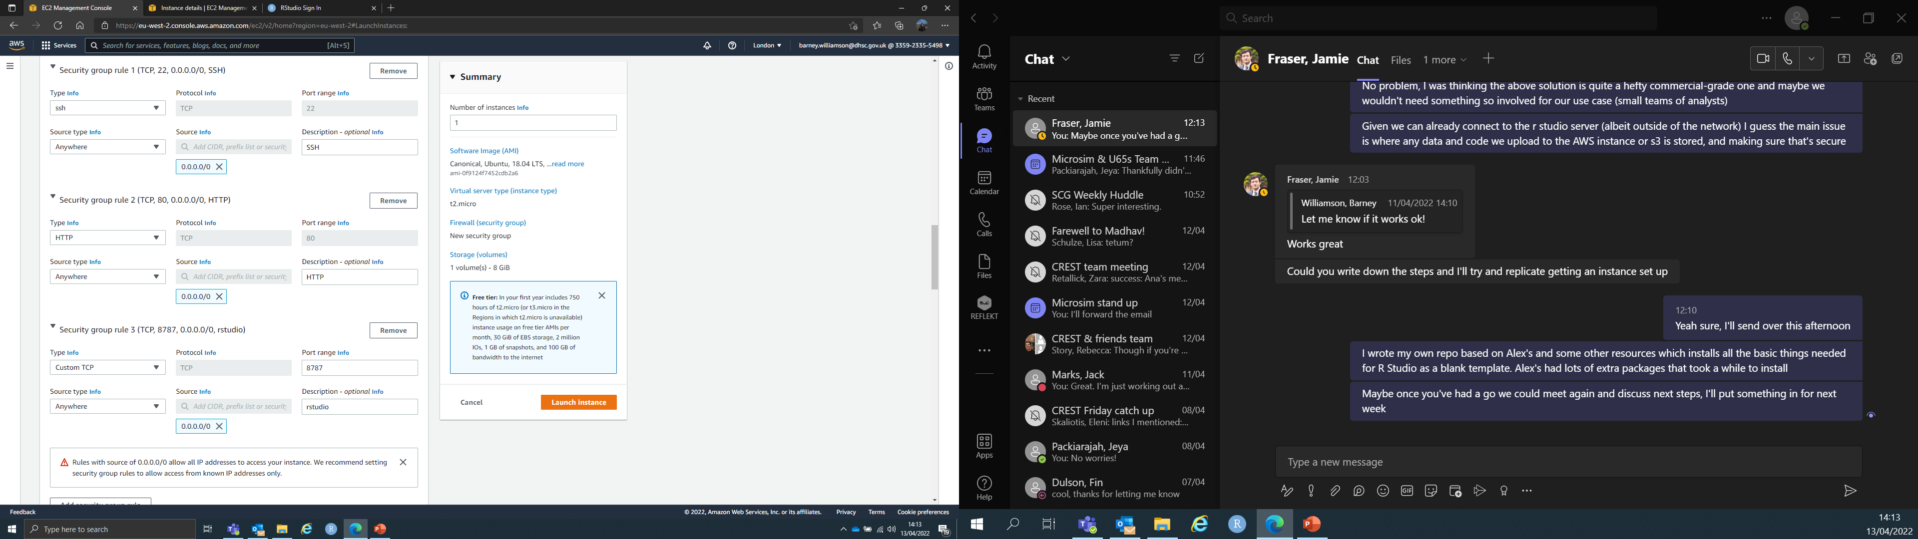
1. Configure and launch AWS instance
Under Network settings, click edit and add your inbound port rules
In total you will need 3 ports:
SSH: port 22
HTTP: port 80
RStudio server default: 8787
For the RStudio server to be accessible the source for all 3 ports needs to be set to ‘anywhere’. This means the connection is open to the world. No sensitive data or code should be uploaded to an AWS instance or RStudio server configured this way. This is a test space only

Slide 6
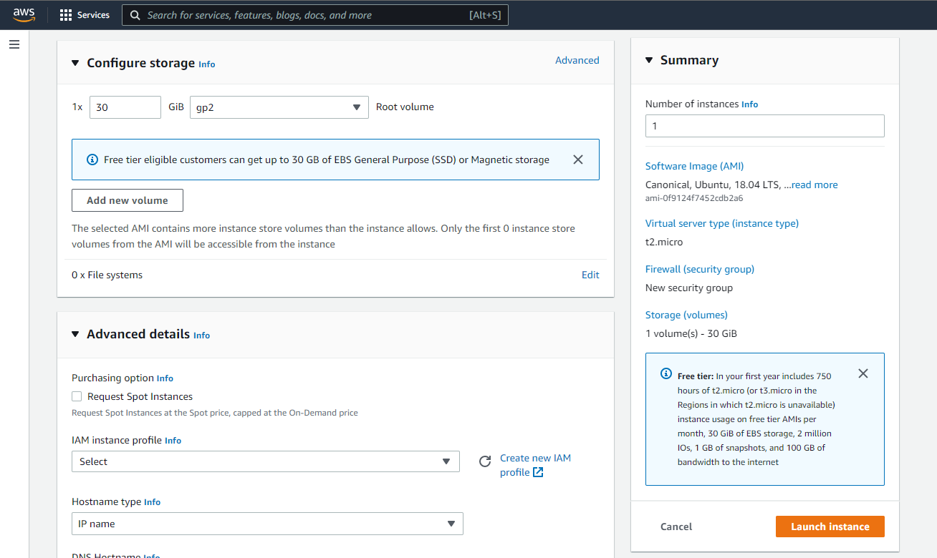
1. Configure and launch AWS instance
Configure storage as needed (increase up to 30 GB in free tier)
All other settings can be left as default. Launch instance

Slide 7
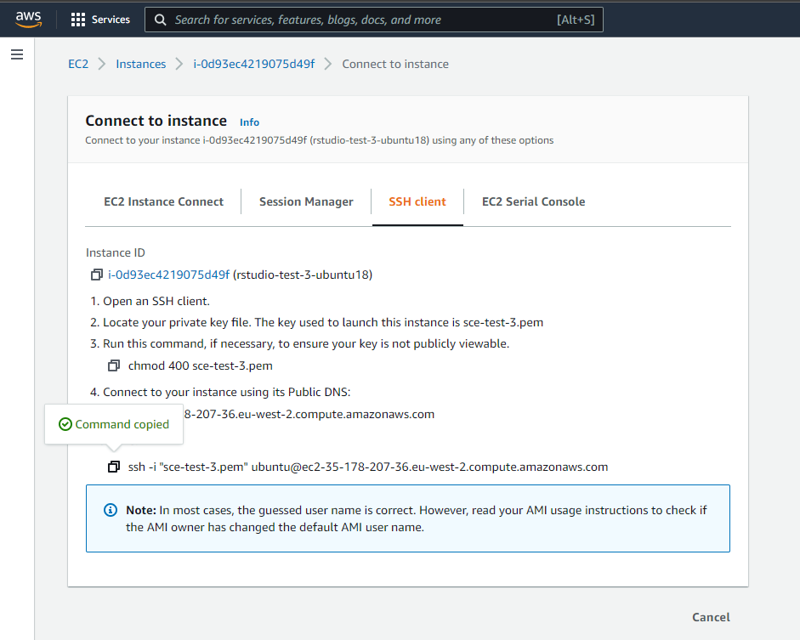
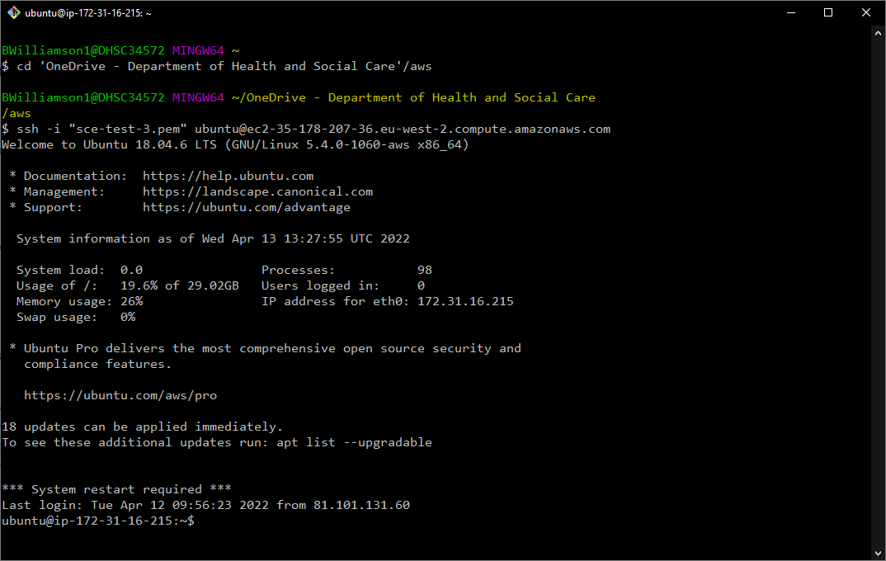
2. Connect to AWS instance
Select your new instance and choose connect from the toolbar
Copy the ssh command from the SSH client option
Use your CLI of choice (PuTTY, GitBash) to navigate to the directory that holds the ssh key pair you downloaded
Run the copied ssh command
ssh –i <key-pair.pem> <address of target machine>

Slide 8
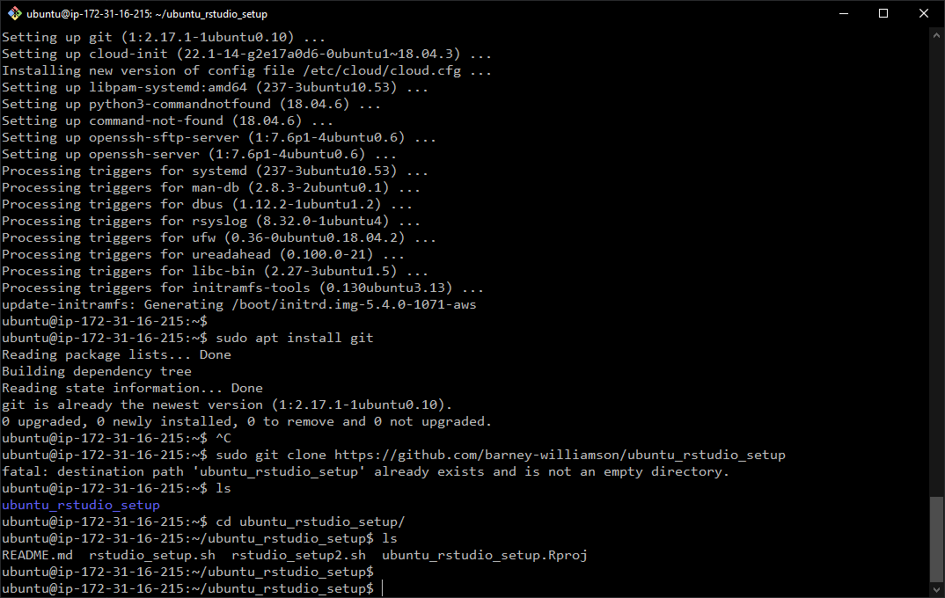
3. Install Git, clone repo and install RStudio server
Call sudo apt install git to install Git
Call sudo git clone https://github.com/barney-williamson/ubuntu_rstudio_setup to clone Git repo
Call sudo sh rstudio_setup2.sh to run installation script. This:
Installs R and package dependencies
Installs RStudio server
Adds a user called ‘rstudio’ on line 35 of script. Change name if required. Command line will prompt for password; these are the credentials used to login to RStudio server

Slide 9
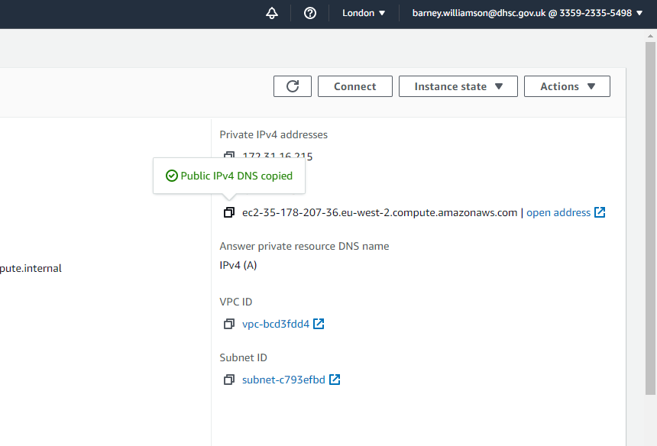
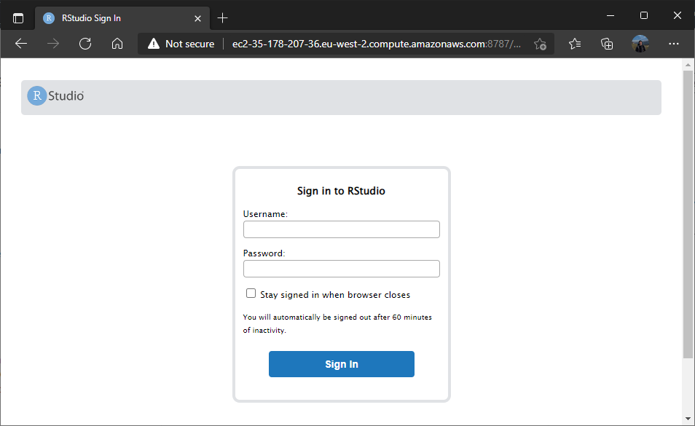
3. Log in to RStudio server
Call rstudio-server status to check if the RStudio server is running
Copy the public address of the instance
Paste this address followed by :8787 (for the RStudio server port) into a browser
Login to your instance with the sudo user credentials created by the installation script

